Slide 1

SMART CITIES & CIVILTECH
Open CivilTech Innovation: Making Urban Services Work Better
Presented by: (TEAM _TITANS)

Slide 2


The Shift to Open Innovation
Citizen-Centric Ecosystems: Transitioning away from top-down generic corporate frameworks to locally tailored municipal infrastructure.
Living Laboratories: Active operational testing grounds utilizing open-source collaborative software like 311 systems.
Breaking Hierarchies: Empowering local grass-roots initiatives to organically influence municipal software iterations directly.

Slide 3

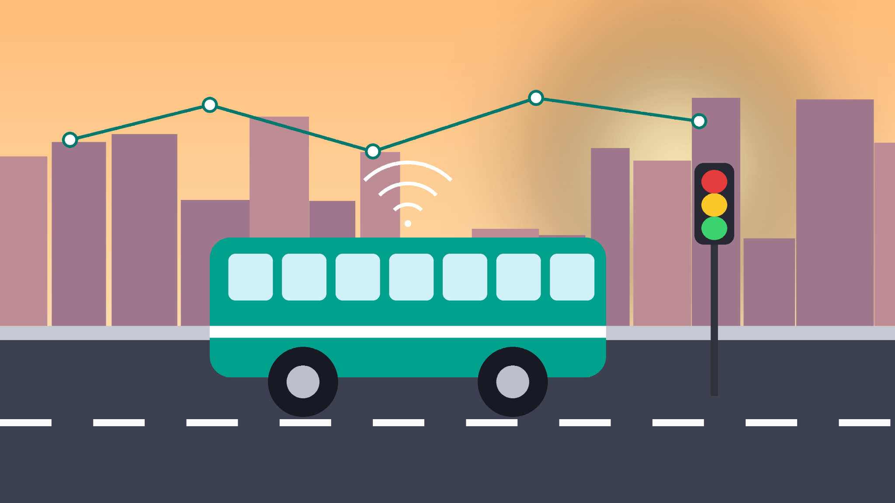
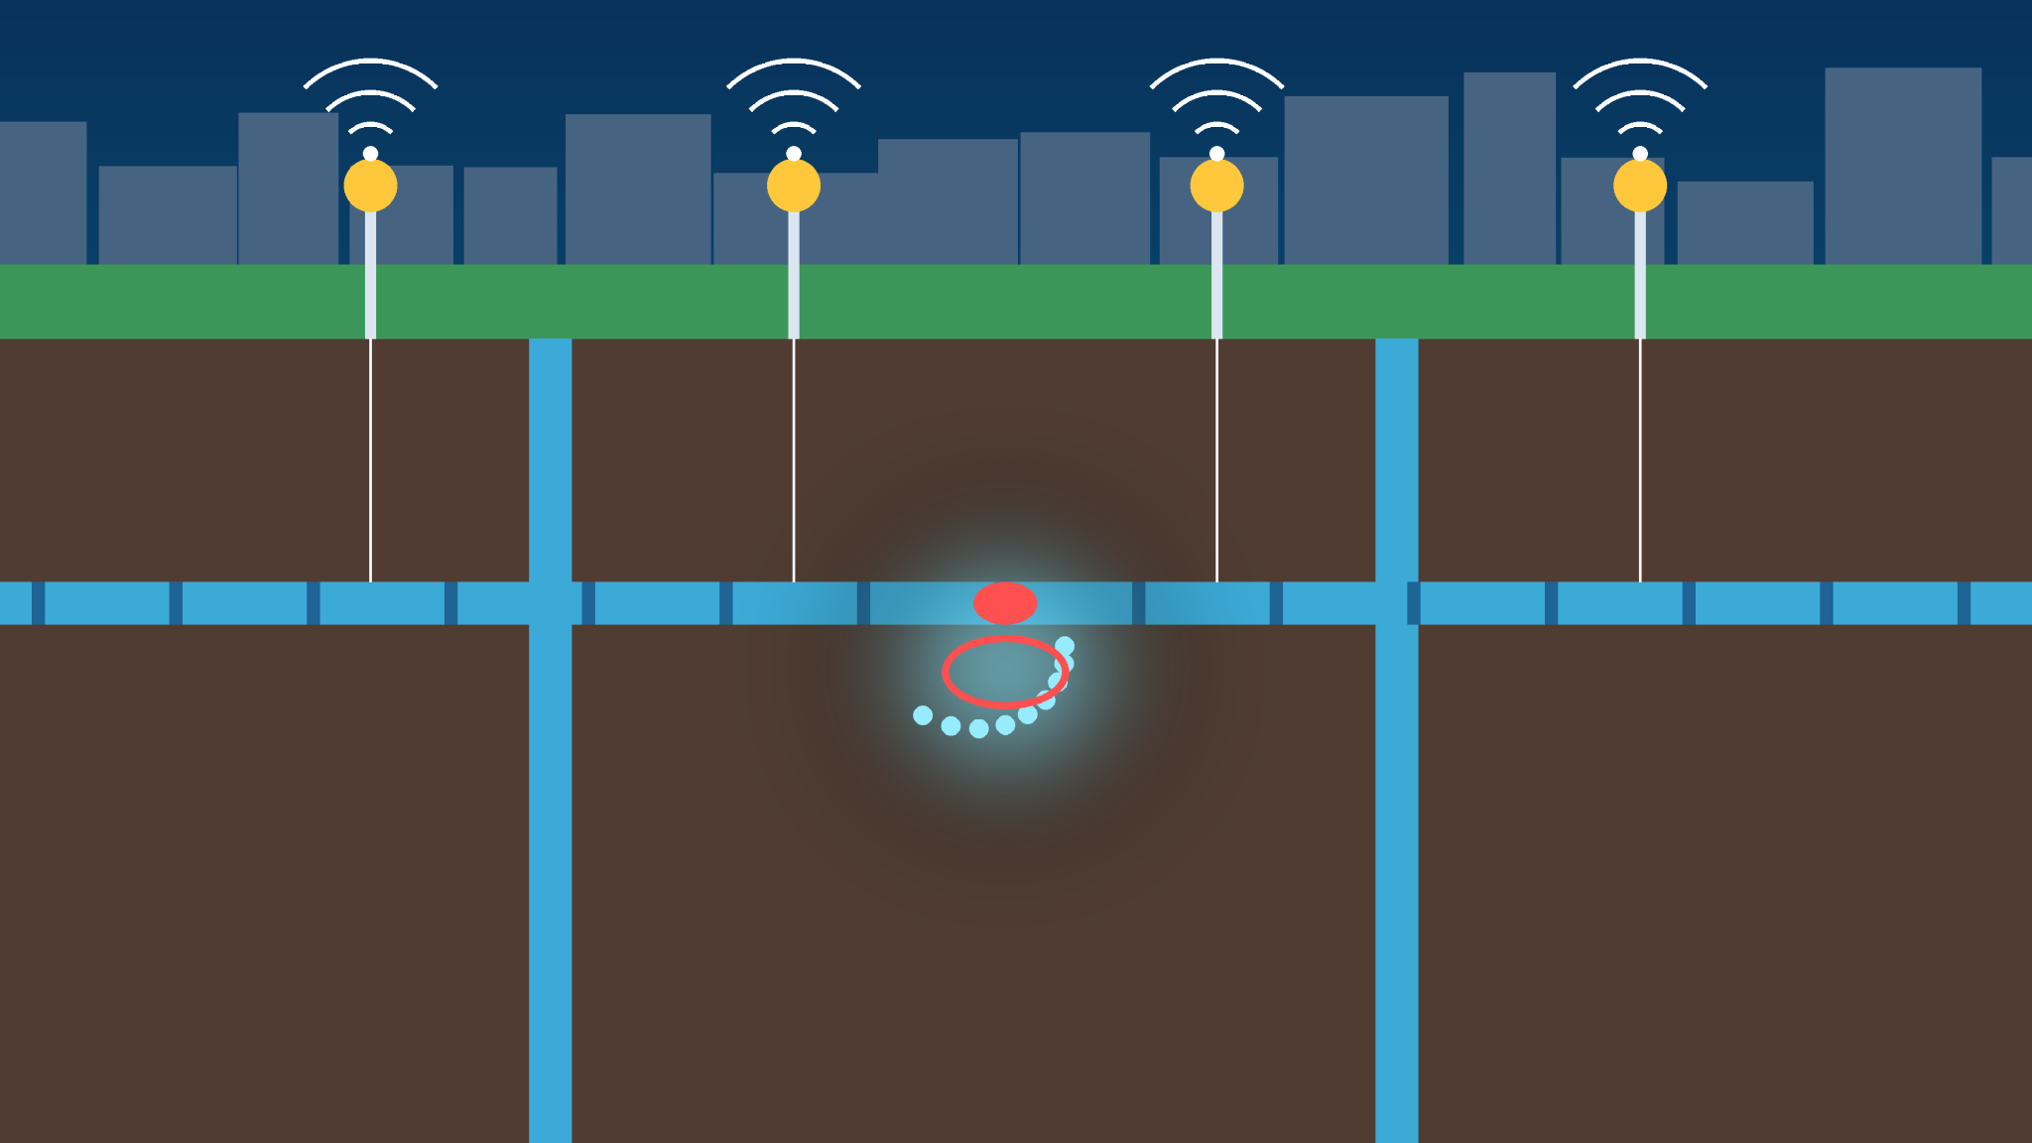
CivilTech Infrastructure Pillars – Part 1
Urban Mobility & Transport: IoT-enabled mass transit nodes integrated directly into cloud data platforms for real-time traffic updates.
Primary Transit Benefit: Dynamic route adjustments yielding rapid carbon emission and congestion drops.
Smart Water Management: Automated Sensing & Data Collection Systems (SDCS) tracking localized structural flow patterns.
Primary Water Benefit: Immediate precision mapping of infrastructure leaks guaranteeing stable, clean urban resource access.

Slide 4


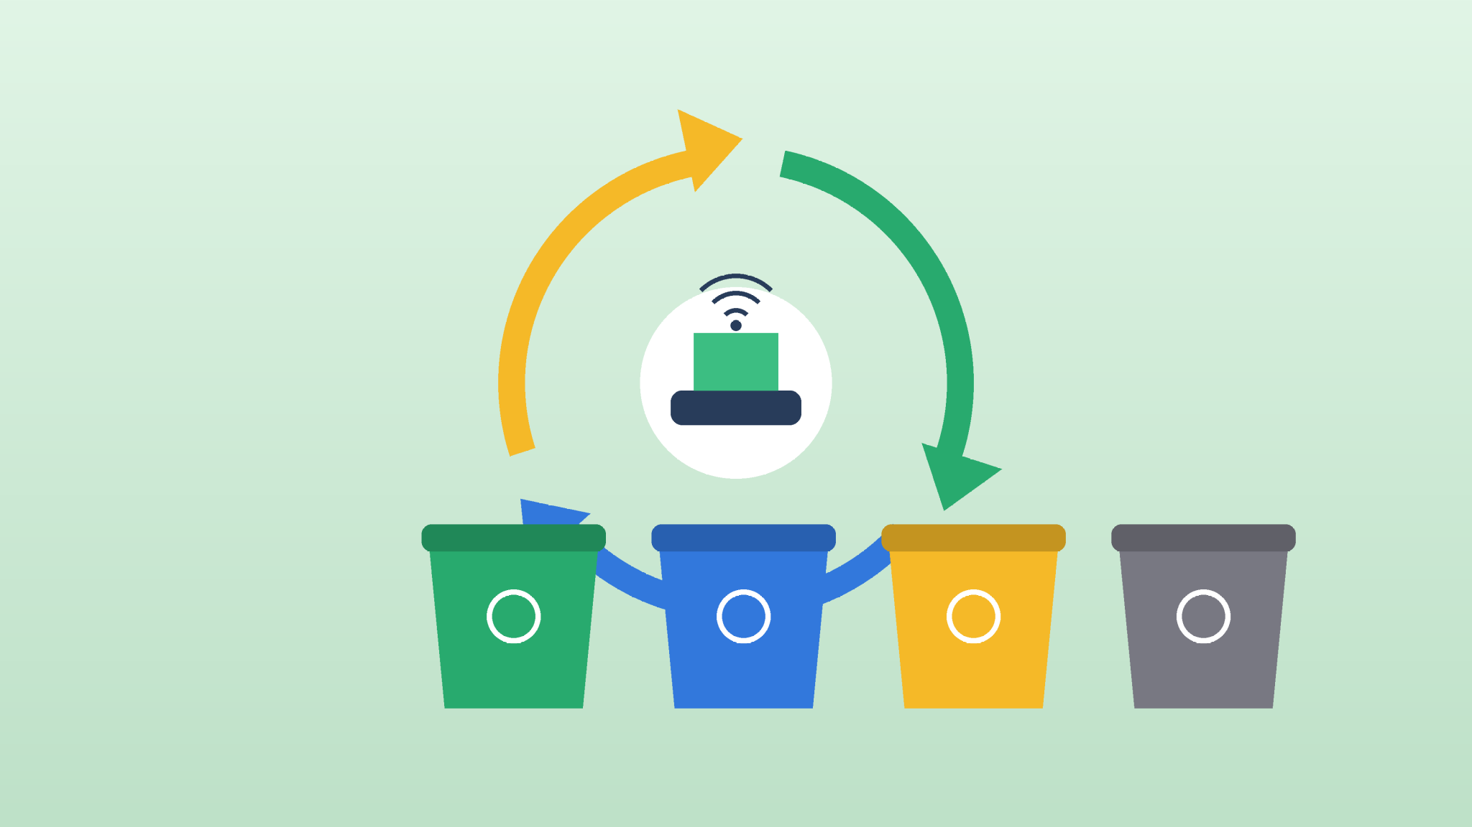
CivilTech Infrastructure Pillars – Part 2
Energy & Smart Grids: Demand-based energy routing matrices embedding localized wind and solar microgrid arrays.
Primary Energy Benefit: Significantly downsized carbon footprints coupled with scalable local backup capacity grids.
Sanitation & Waste Networks: 'Zero Waste' target operational schemas incorporating weight-sensing tracking logistics.
Primary Waste Benefit: Drastically streamlined solid refuse sorting to construct reliable circular economic loops.

Slide 5


CivilTech Infrastructure Pillars – Part 3
Housing & Public Spaces: Universally accessible, non-exclusionary modular structural assets serving urban centers.
Climate Resilience: Civil engineering layouts structured specifically to absorb immediate, unpredictable environmental shifts.
Socioeconomic Vulnerability: Deploying low-cost adaptive building profiles protecting low-income demographics from displacement.

Slide 6

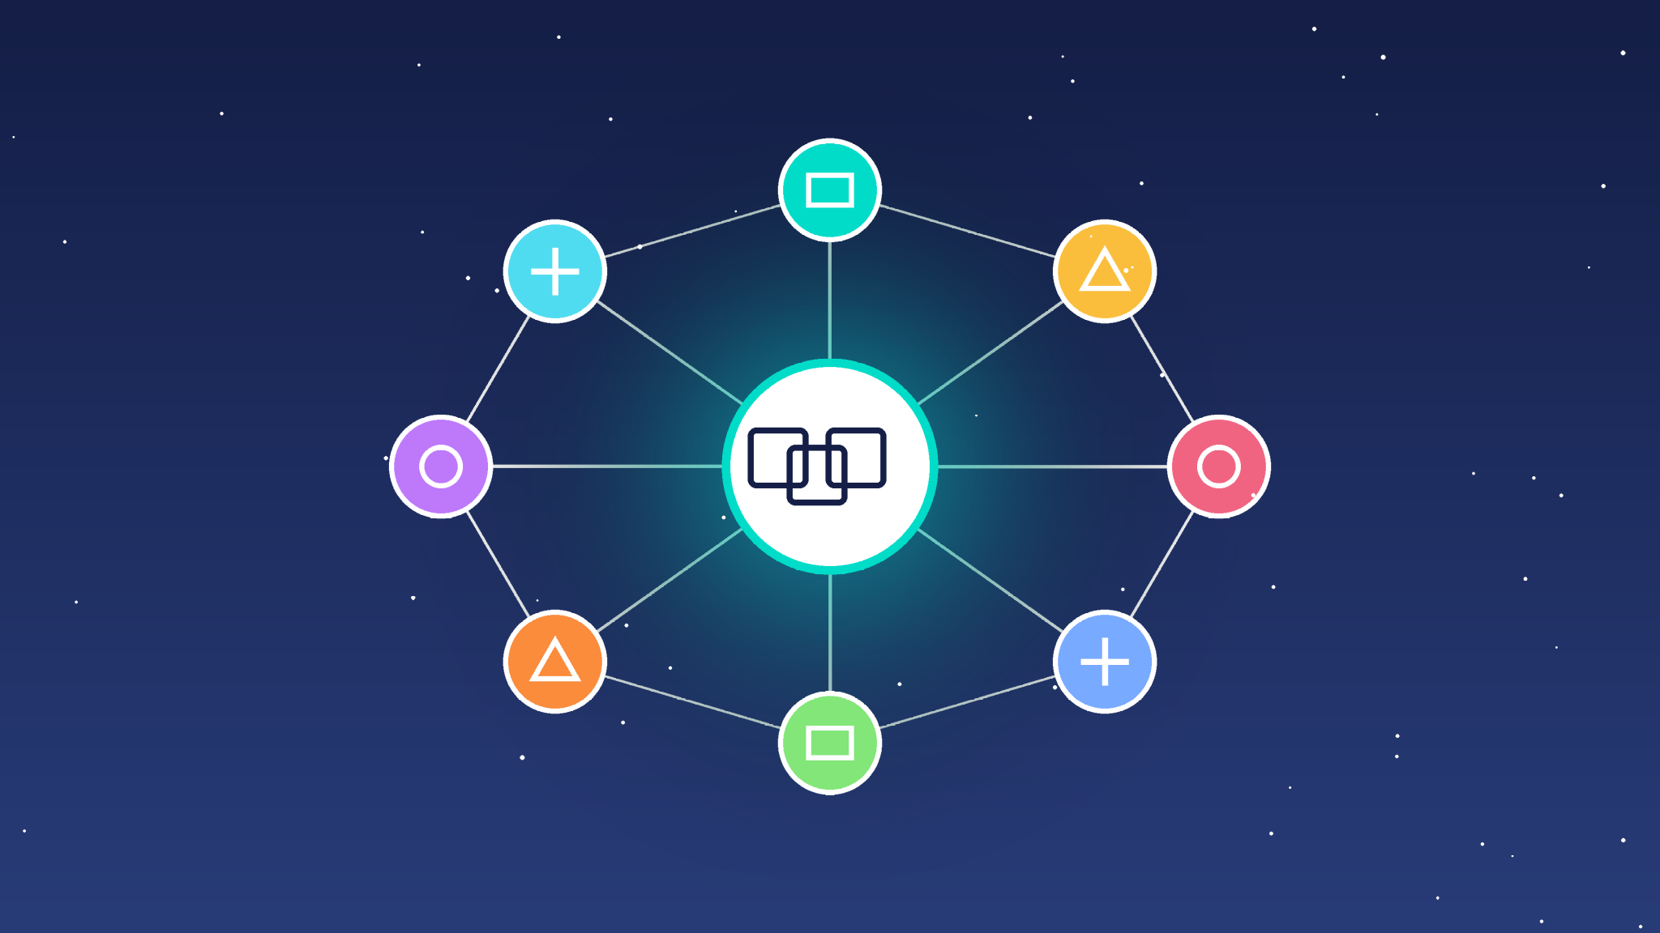
How Open Innovation Drives Value
Local Tech Ecosystems
Utilizing municipal frameworks as active testbeds for open-source municipal software applications to unlock native entrepreneurial potential.
Interoperability Assets
Basing builds on standardized open pathways like ITU-T Y.4200 series recommendations to remove single-vendor proprietary dependencies.
Agile Decentralisation
Bypassing heavy, deadlocked city administration layers to allow fast, direct feature updates sourced straight from resident feedback networks.

Slide 7


Centralized Civic Governance Architecture
Integrated Command & Control: Consolidating distributed departmental metrics (ICCCCs) into singular operational visual dashboards.
Real-Time Civic Oversight: Synchronously tracking multi-vector data points covering everything from flash environmental risks to daily mass transit loads.
Eradicating Silos: Replacing disconnected tech operations with unified, collaborative modern public safety structures.

Slide 8
Thank You
Building smarter, more open cities together
Presented by: (TEAM _TITANS)

